Slide 1

Analyzing Opening Choices and Player Strengths in Online Chess: A Network Analysis Approach
Serkan Kütük – 27054
Özge Karasu – 26508
Gürkan Taha Soylu – 26883
Taner Dinçer – 26889
Uğur Öztunç - 28176

Slide 2
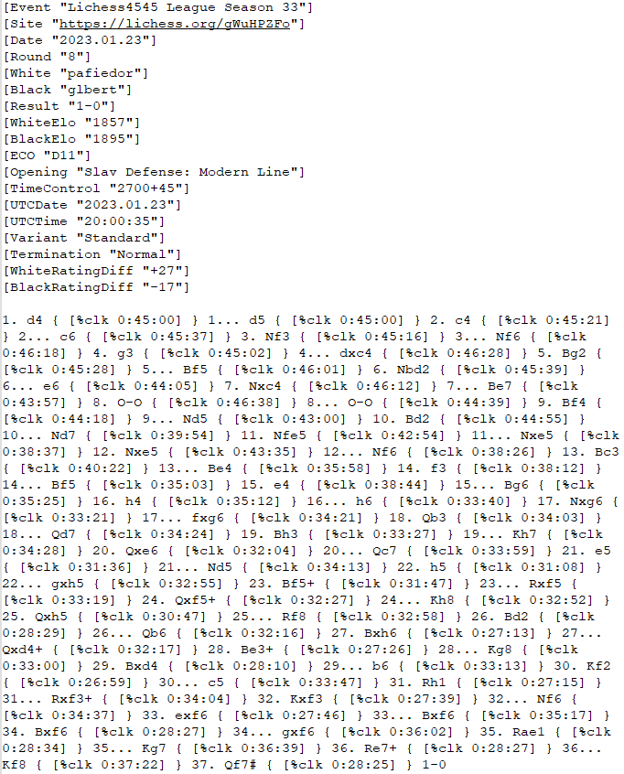
Dataset
2015.11.01 – 2021.01.23
31188 Matches
3498 Players
473 Different Openings
Lowest Elo score – 802
Highest Elo score - 2641

Slide 3
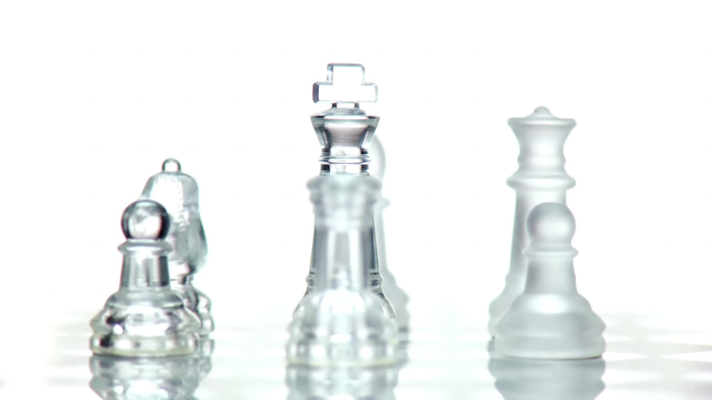
Objectives
Investigating the relationship between the openings and the chess level of players, which are determined by their Elo-ratings, using visual network analysis and statistics
Analyzing the chess community and different playing habits, by benefiting from network analysis techniques such as closeness and betweenness centrality, in the framework of network science
Establishing a link between player level and gameplay habits using the Community Detection algorithm, Louvain method

Slide 4

Literature Review
Quantifying The Complexity And Similarity Of Chess Openings Using Online Chess Community Data
Structure Constrained By Metadata In Networks Of Chess Players

Slide 5
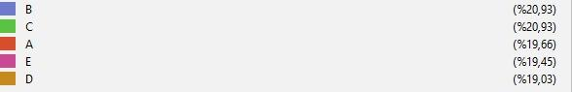
The Visual Analysis Of Bipartite Network

Slide 6
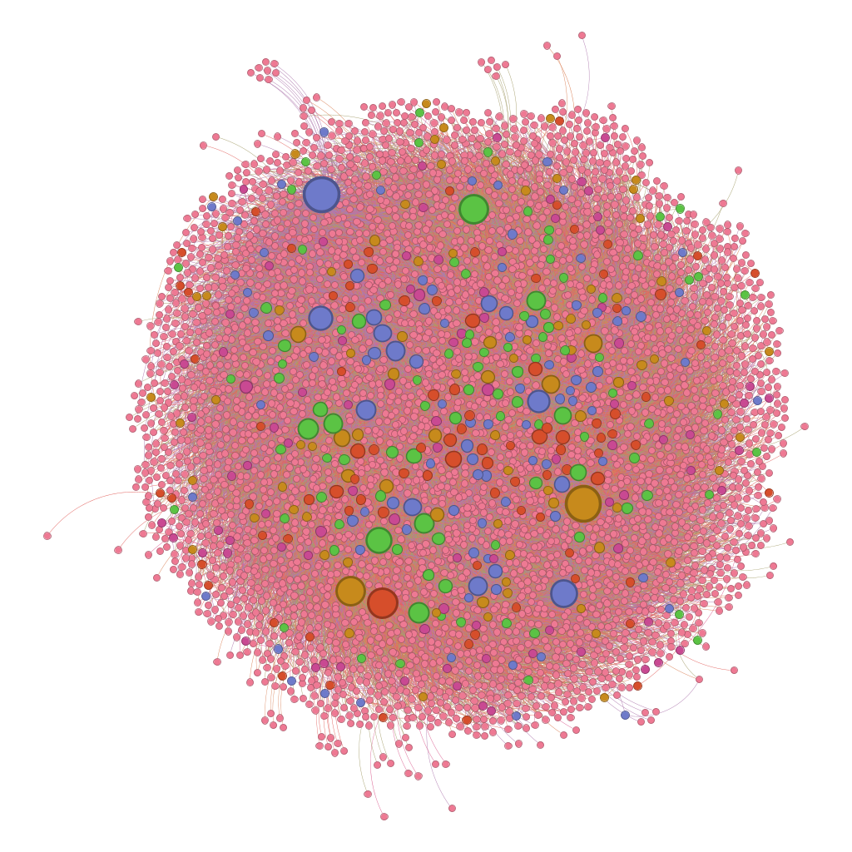
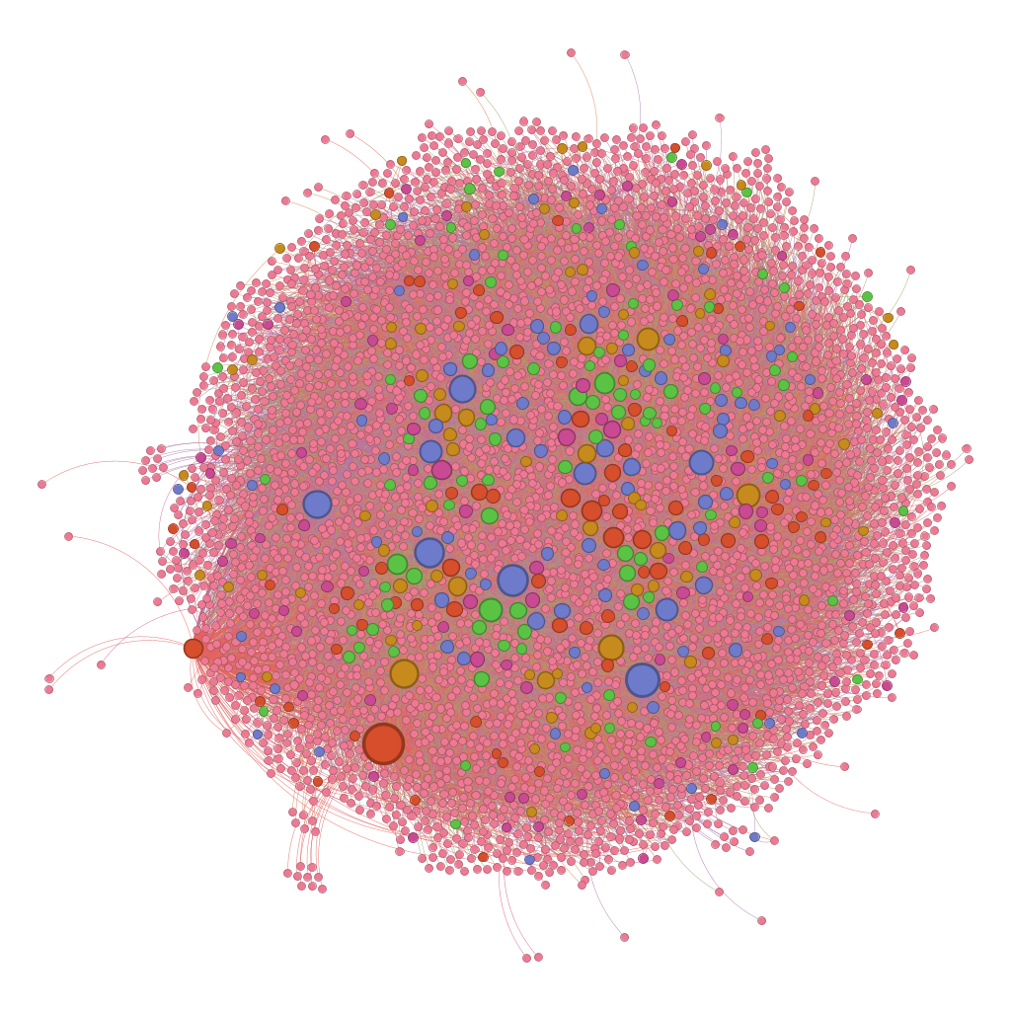
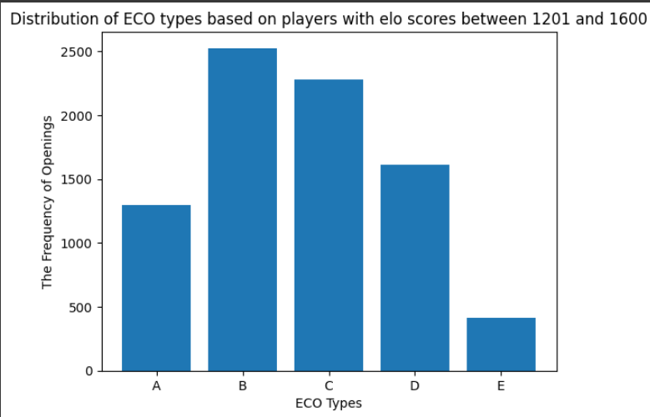
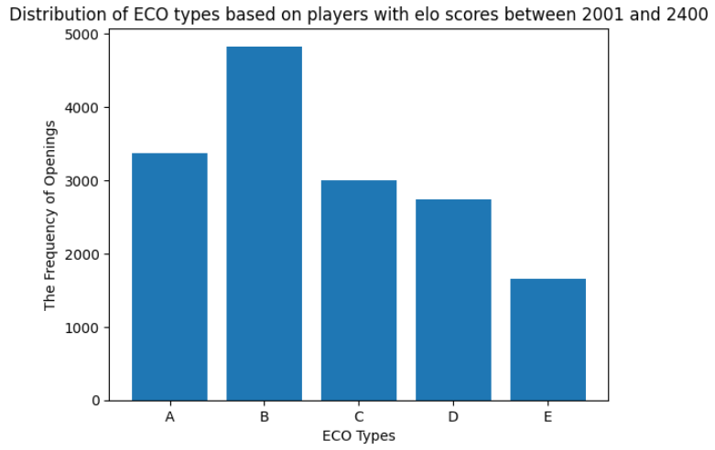
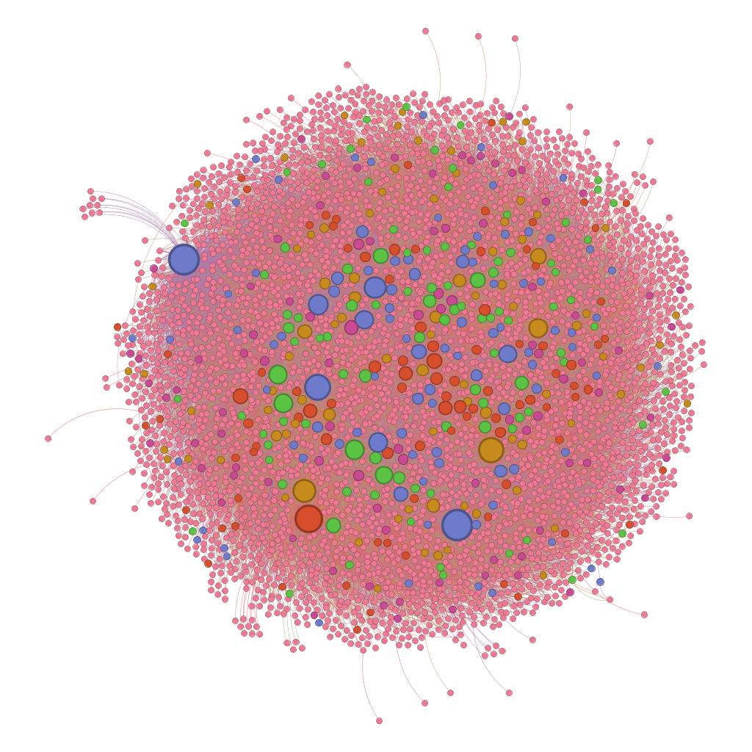
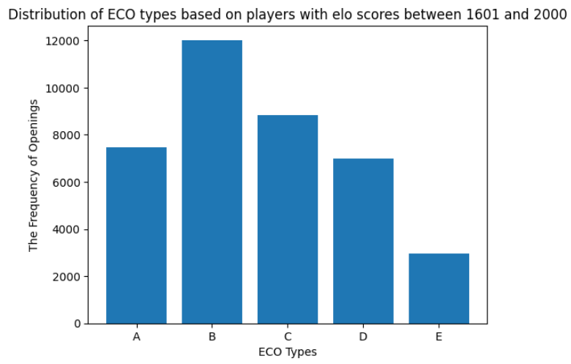

Slide 7
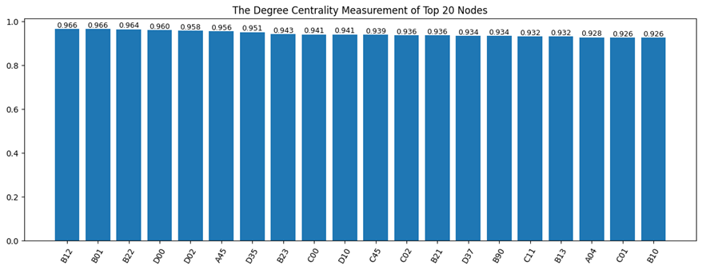
The Mathematical Analysis of Bipartite Network

Slide 8

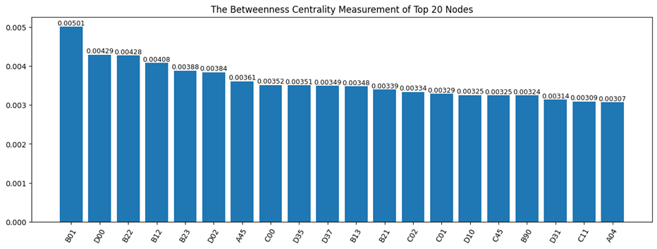

Slide 9
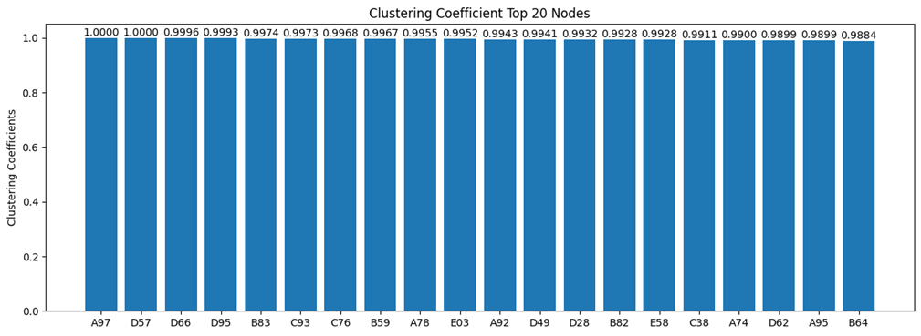
Radius Of Network | 2
Diameter Of Network | 3
Periphery Of Network | ‘A93’ – ‘E59’ – ‘D57’
Centre Of Network | ‘B12’ – ‘B01’ – ‘B22’
Average Path Length | 1.39

Slide 10
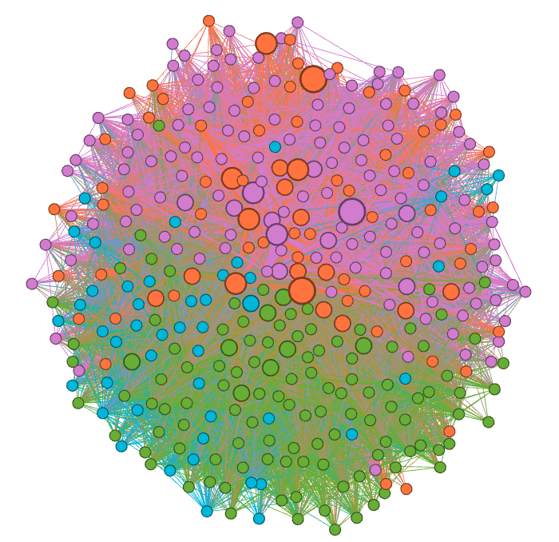
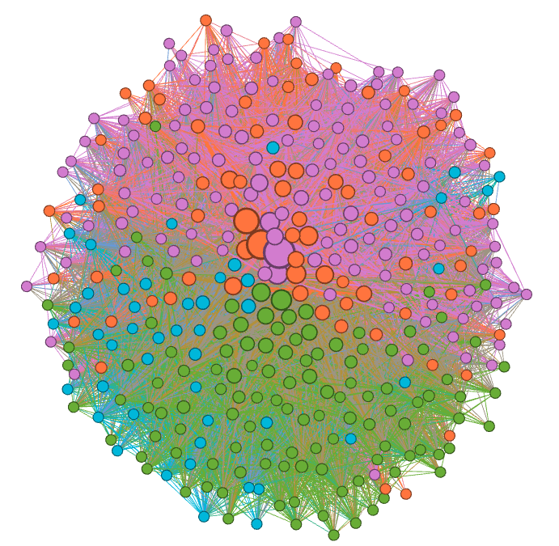
Community Detection
800-1200 rating group, colorized by the community detection
1201-1600 rating group, colorized by the community detection

Slide 11
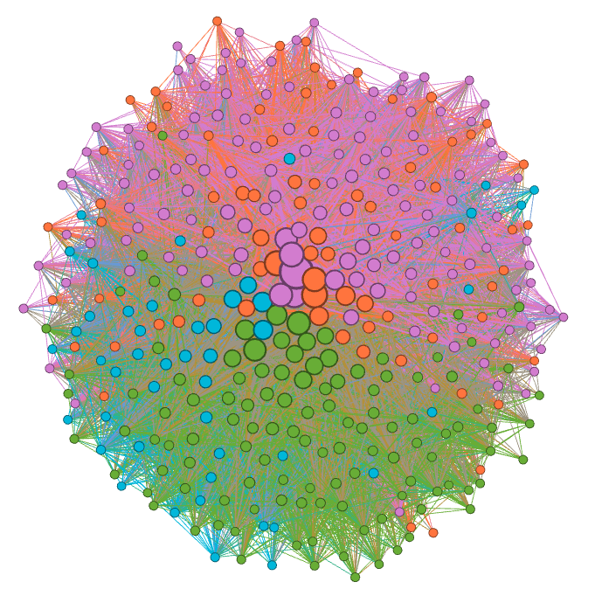
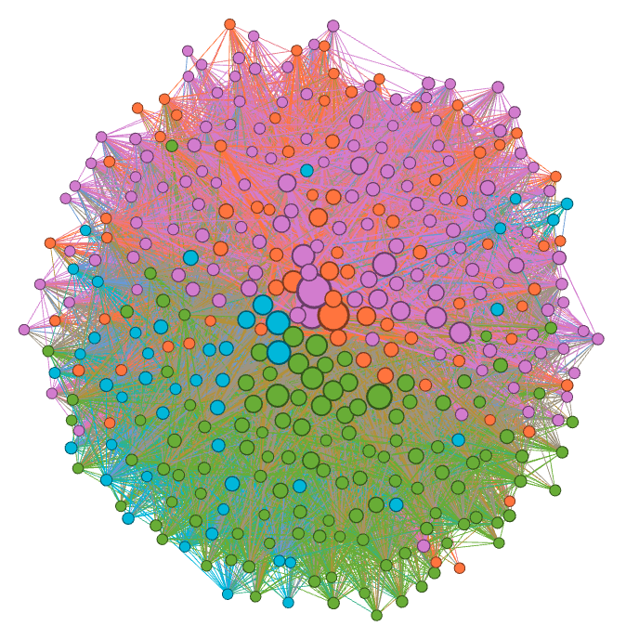
1601-2000 rating group, colorized by the community detection
2001-2400 rating group, colorized by the community detection

Slide 12
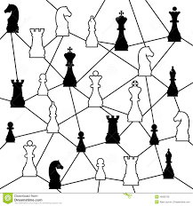
Conclusion

Slide 13

References
About lichess.org. (n.d.). Retrieved from lichess.org: https://lichess.org/about
Almeira, N., Schaigorodsky, A. L., Perotti, J. I., & Billoni, O. V. (2017). Structure Constrained By Metadata In Networks Of Chess Players. Nature.
Marzo, G. D., & Servedio, V. D. (2023). Quantifying the complexity and similarity of chess openings using online chess community data. Nature.
Images used in the Slide
https://assetsio.reedpopcdn.com/chess-playing-hand.jpeg?width=1600&height=900&fit=crop&quality=100&format=png&enable=upscale&auto=webp
https://images.chesscomfiles.com/uploads/v1/article/24364.c1656340.668x375o.af56013e623b@2x.jpeg
https://www.dreamstime.com/stock-illustration-chess-network-creative-smart-pieces-image49090738

